Slide 1
Spark MLLib

Slide 2
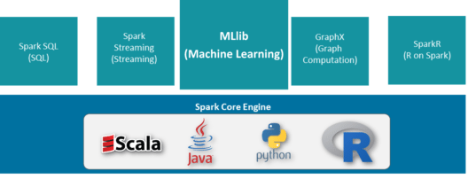
What is PySpark MLlib?
A machine-learning library
A wrapper over PySpark Core to do data analysis using machine-learning algorithms
Has implementations of
Classification
Clustering
Linear regression

Slide 3
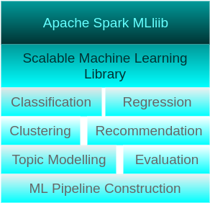
MLlib Features
Data Source
HDFS
HBase
Local Files
Excels at iterative computation

Slide 4
Algorithms
Classification using Logistic Regression
Classification using Naive Bayes
Generalized Regression
Survival Regression
Decision Trees
Random Forests
Gradient Boosted Trees
Recommendation using Alternating Least Squares (ALS)
Clustering using KMeans
Clustering using Gaussian Mixtures
Topic Modelling using Latent Dirichlet Conditions
Frequent Itemsets
Association Rules
Sequential Pattern Mining

Slide 5
MLlib Utilities
Feature Transformation
ML Pipeline construction
Model Evaluation
Hyper-parameter tuning
Saving and loading of models and pipelines
Distributed Linear Algebra
Statistics

Slide 6
MLlib vs scikit-learn
Scikit-Learn has fantastic performance if your data fits into RAM
Spark’s ML Lib is suitable when you’re doing relatively simple ML on a large data set
ML Lib is not computationally efficient for small data sets, and you’re better off using scikit-learn for small and medium sized data sets (megabytes, up to a few gigabytes). For much larger data sets, use Spark ML.
MLlib lacks in visualization
Sklearn is far richer in terms of decent implementations of a large number of commonly used algorithms as compared to spark mllib
Scikit-Learn integrates very well with Pandas dataframes and can work on Numpy and Pandas data structures. This is not the case with Spark - where you have to use Spark’s native dataframes or RDDs to execute the computation.

Slide 7
Various ML algorithms supported by MLlib
Classification
Logistic regression
Binomial logistic regression
Multinomial logistic regression
Decision tree classifier
Random forest classifier
Gradient-boosted tree classifier
Multilayer perceptron classifier
Linear Support Vector Machine
One-vs-Rest classifier (a.k.a. One-vs-All)
Naive Bayes

Slide 8
Various ML algorithms supported by MLlib
Regression
Linear regression
Generalized linear regression
Decision tree regression
Random forest regression
Gradient-boosted tree regression
Survival regression
Isotonic regression
Decision trees
Tree Ensembles
Random Forests
Gradient-Boosted Trees (GBTs)

Slide 9
Various ML algorithms supported by MLlib
Clustering
K-means
Bisecting k-means
Gaussian Mixture Model (GMM)
Collaborative filtering

Slide 10
Thanks

